Slide 1
Contemporary Series:
The Physics of Bassoon Reeds
A guide by Stuart Young II

Slide 2
Foreword:
How most people learn to make reeds is by diving right into scraping and manual tweaking.
YES AND NO!!
Although terminologies differ between science and music, principals in sound are the same.
By knowing the fundamentals in physics (with help from other instruments) and geometry, bassoonists can know what to adjust for before putting the reed in the mouth!

Slide 3
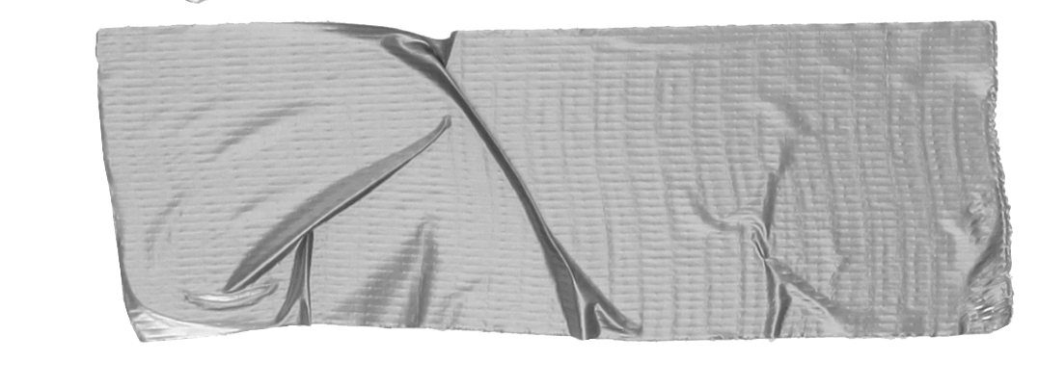
1. “What is Music?”: Physics Edition
Here are some terms that you really should know…
Harmonic Series Sequence of harmonics whose frequency is an integer multiple of a pitch
Nodes Point in which there is little vibration
Overtone Any harmonic whose frequency is greater than the fundamental (starting) pitch

Slide 4
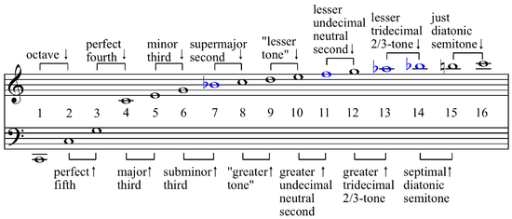
The Harmonic (Overtone) Series
1 frequency = All intervallic frequencies above the fundamental

Slide 5
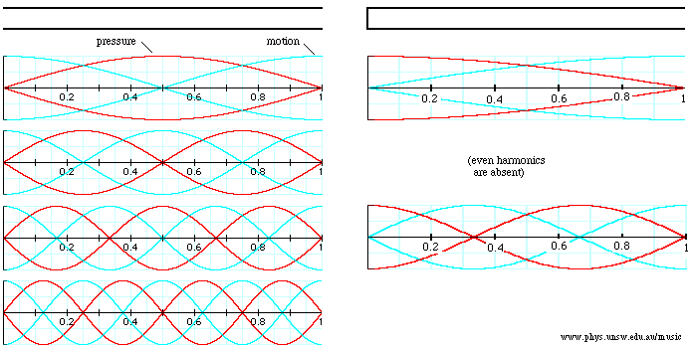
Tubes! Cylindrical Bore
Open Cylindrical Tube (Even)
Closed Cylindrical Tube (Odd)
Tip!
Think of nodes as fingers on a string! The frequency is doubled when the string is halved (This is an octave)

Slide 6
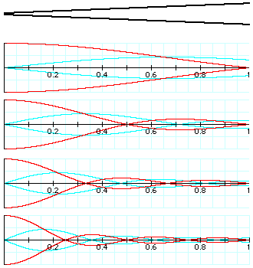
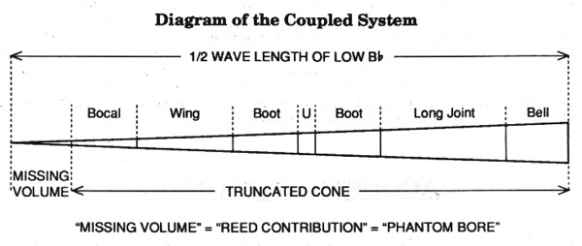
Tubes! Conical Bore
The tone holes evenly spaced and made roughly the same size, and musicians must compensate for the loss in amplitude at higher frequencies.

Slide 7
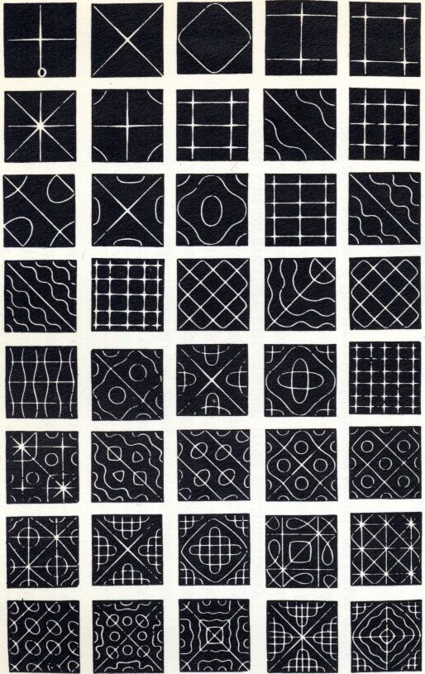
Chladni Plates - The Nodes
Video
https://youtu.be/tFAcYruShow

Slide 8
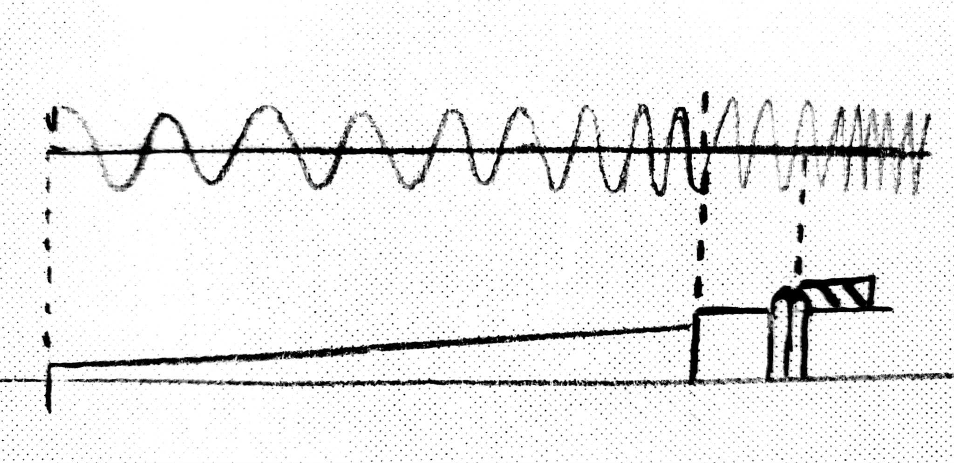
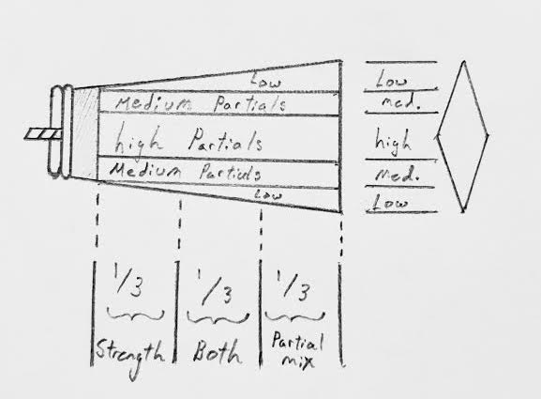
Using Chladni’s plates, Vibrations on REED BLADES are easily to conceptualize!

Slide 9
2. Onto the Reed
By the end of this section, your audience should be able to visualize:
Physics How vibrations are displaced throughout the reed (Thank you Chladni)
Geometry Provide insight on the concepts of a balanced reed and its symmetry

Slide 10
Conical Bore! Conical Reed!

Slide 11
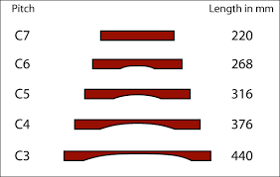
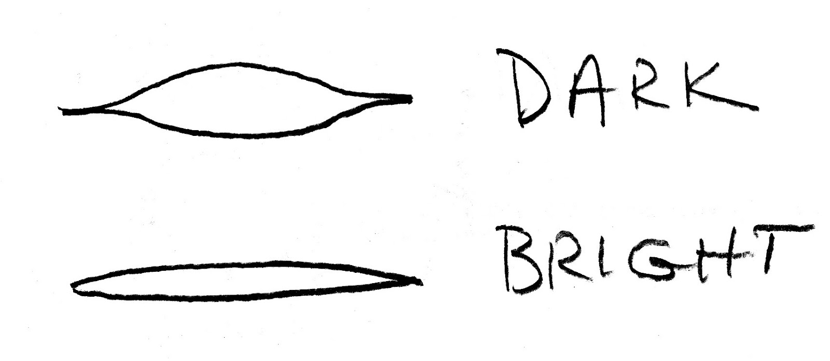
Starting from the Tip!
The tip and blade profile are similar in vibrating properties as the bars on a marimba!

Slide 12
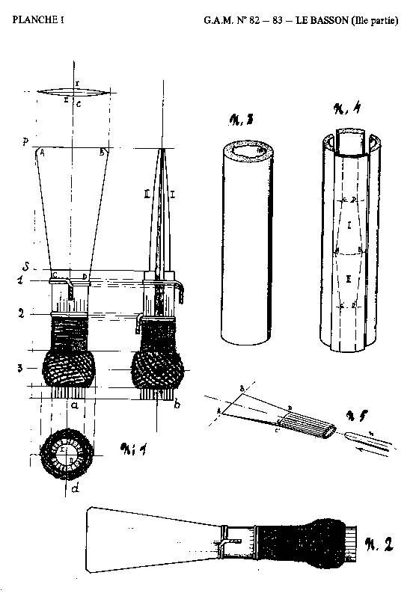
The Shape
To fulfill missing volume, the bore must match the slope.
The thin, wide tip and the thick narrow shoulder are fundamental for any performable reed.
Wires help establish an area of wave dampening. (Nodes, nodes!)

Slide 13
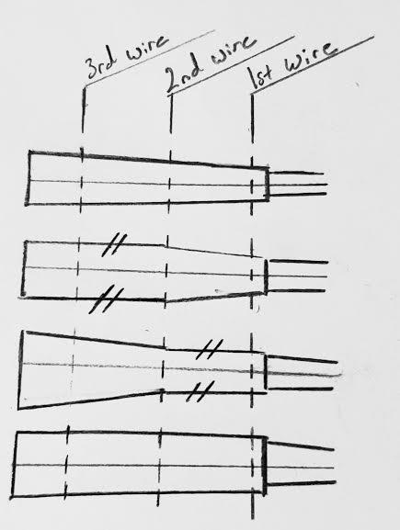
The Fulcrum
Conical Fulcrum achieves 100% Missing Volume
Parallel points add resistance (Not a bad thing)
Third wire should have the least amount of adjusting

Slide 14
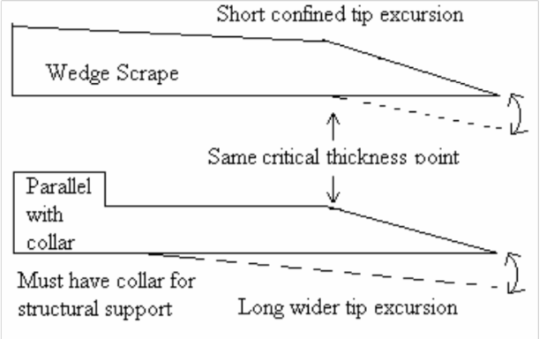
The Topography
The wedge from the tip helps with response and should stop at the heart.
Structural support for the reed comes from the back of the reed.
True Parallel offers the most support, but does not fulfil the conical slope.

Slide 15
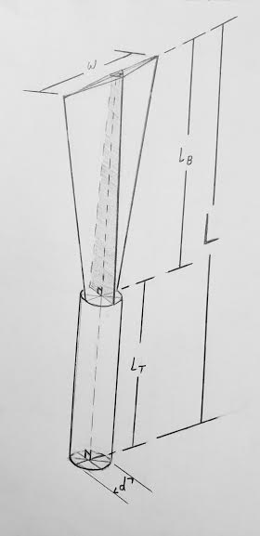
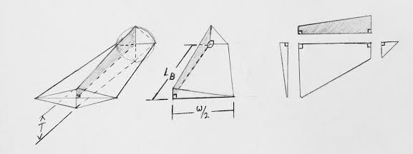
Math - “The Language of the Universe”
Math will show us what’s at the “surface level.”
To grasp the full geometric breakdown of the reed, find the surface area and volume.

Slide 16
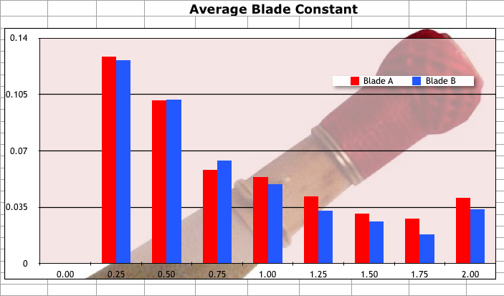
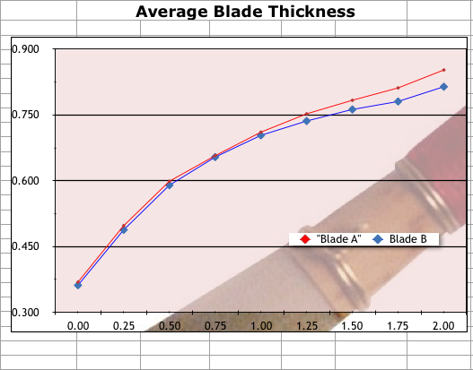
Remember this…
Area:
Tube: AT = π(d+R2)√((r-R2)^2+Lb^2)
Tip: At = w*h
Throat: Ath = 4(R^2/2)
Horizontal trapezoid: AHT = 2((½w+R)/2)Lb
Vertical trapezoid: AVT = 2((½h+R)/2)Lb
Hypo. trapezoid: AHY = (½(R^2+(w/2^2+h/2^2))/2)Lb
Blade: AB = (w*h)+2(AHT + AVT + 2AHY)
Reed: Atot = AT + Ab
Volume:
Tube: VT = πLb/3(r^2+r*R2+R2^2)
Blade: Vb = 4((At*Ath)h*R/2Lb)
Reed: Vtot = VT + Lb

Slide 17
Do I expect you to know the surface area for all your reeds?
No!
But math can also be an essential reed tool for how to “balance” a reed. In part with knowing the physics, reed makers can better pinpoint reed issues and adjust.

Slide 18
3. Closing
There were a lot of words used, let’s debrief…:
Physics Cone bores, nodes, all-harmonics
Mathematics Prove the physics behind reed making and adjusting
Reed Making Fulcrum, missing volume, topography

Slide 19
What did we learn?
Frequency and nodes on the blade generate vibrancy
Thank you, Chladni
Harmonic balance and mathematics balance are crucial
Math is as important as a reed knife
The Missing Volume should follow the taper of the horn
Especially at the bocal
“The disciplines of music are accompanied by physics. Thus, musicians are both artists and acousticians.”

Slide 20
Thank You
Eubanks, Mark G.,
“Advanced Reed Design & Testing Procedure for Bassoon,” Artundo Research Company, 1993
Palmer, Thomas H.,
“A Study of the Air Gap Between Blades of a Reed: (The Journal, International Double Reed Society, No. 4, 1976).”
Cooper, L. Hugh,
“Reed Contribution,” The Double Reed, Volume 13, No. 3, 1990.
Clarke, Dale,,
“Points of Resistance on Bassoon Reeds,” The Double Reed, Volume 23, No. 4, 2000.
Young II, Stuart E.,
“The Physics of Bassoon Reeds - A Mathematical Approach to Reed Making,” Project Blue Studios, 2017.

