Slide 1
Contemporary Series:
Pioneers of
Electronics in Music
Stuart Young

Slide 2
Before we begin…
Adjective: Synthetic
1. (of a substance) made by chemical synthesis, especially to imitate a natural product.
2. (of an emotion or action) not genuine; insincere
Noun: music
1. vocal or instrumental sounds (or both) combined in such a way as to produce beauty of form, harmony, and expression of emotion.
2. the written or printed signs representing vocal or instrumental sound.
Definitions provided by Oxford Dictionary

Slide 3
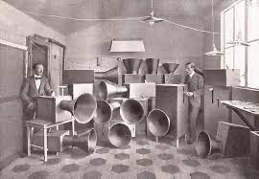
Luigi Russolo - “The Art of Noises”
April 30, 1885 - February 6, 1947
“Futurist painter, composer, and builder of experimental music instruments
The Intonaurmori
Audiences are accustomed to urban, industrialized soundscapes.
New sounds will “substitute for the limited variety of timbres that the orchestra possesses…”

Slide 4
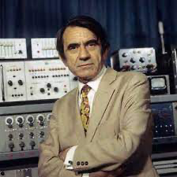
Pierre Schaeffer - “Musique Concrete”
August 14, 1910 - August 19, 1995
Composer and engineer
Musique Concrete - Creating music with only source material
“Godfather of Sampling”
https://www.youtube.com/watch?v=CTf0yE15zzI

Slide 5
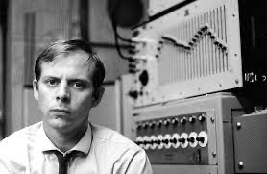
Karlheinz Stockhausen - “Elektronische Musick”
August 22, 1928 - December 5, 2007
Composer, NOT engineer
New Music - early synthesizer
https://www.youtube.com/watch?v=1GoUzk6fQAA

Slide 6
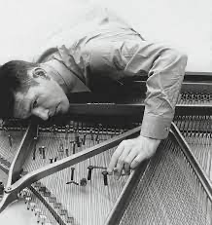
John Cage - “What is ‘Music’?”
September 5, 1912 - August 12, 1992
Post-war Avant Garde Pioneer
Known for non-standard use of instrumentation
“All-Sound” music theorist
https://www.youtube.com/watch?v=dH9IvOmKBMo

Slide 7
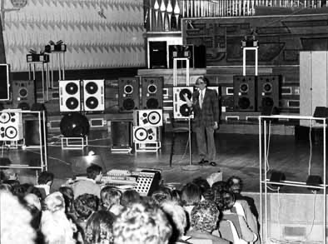
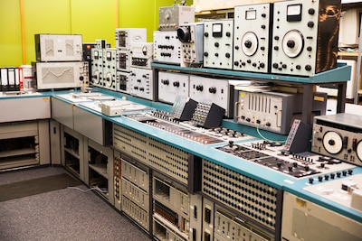
Meet the Instruments!
Schaeffer and the Acousmonium (1974)
Stockhausen Studio Set (1970)

Slide 8
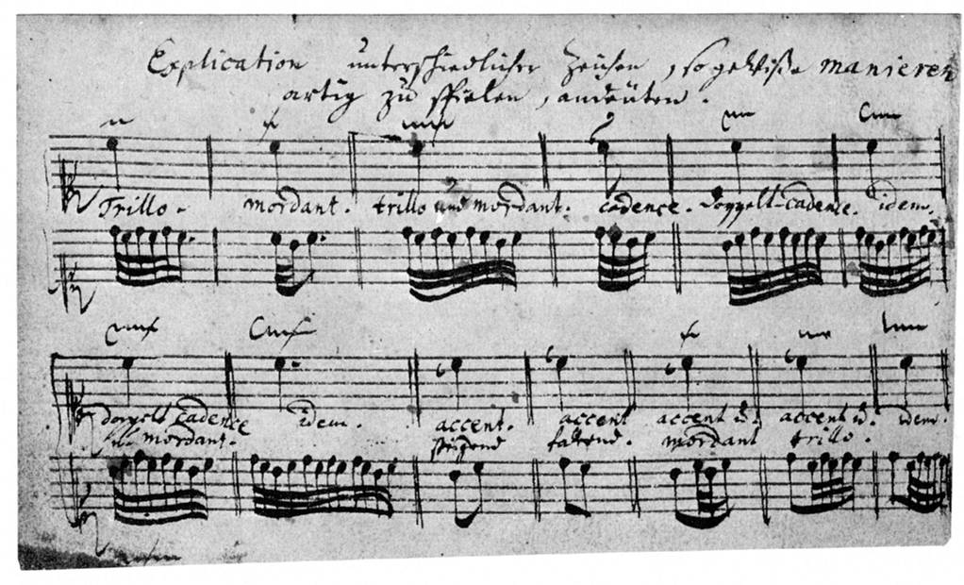
Where else have we experimented in sound?
Jean-Henri d’Anglebert’s table of ornamentation, 1689

Slide 9
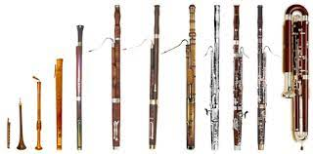
Where else have we experimented in sound?
Bassoon itself!

Slide 10
A New Wave - Pioneering Acoustic with Media
The Buggles, “Video Killed the Radio Star” (1981) https://www.youtube.com/watch?v=W8r-tXRLazs
Muse, “Thought Contagion” (2018) https://www.youtube.com/watch?v=QQ_3S-IQm38
Jacob ter Doest, “Jesus is Coming” (2003) https://www.youtube.com/watch?v=BNaOaqpmXI4
Hans Zimmer, “Interstellar - Theme” (2014) https://www.youtube.com/watch?v=UDVtMYqUAyw
(Listen for different electronic methods used!)

Slide 11
Before we end…
Sound is sound!! - Electronics don’t imitate, we associate the unfamiliar with familiar!
Adjective: Synthetic
1. (of a substance) made by chemical synthesis, especially to imitate a natural product.
2. (of an emotion or action) not genuine; insincere
Noun: music
1. vocal or instrumental sounds (or both) combined in such a way as to produce beauty of form, harmony, and expression of emotion.
2. the written or printed signs representing vocal or instrumental sound.

Slide 12
What’s next (Rhetorical, please stay shut)
Where will music be in the next 20 years? The next 50 years?
What are ways to create “new sounds” on YOUR instrument?
How would you alter Oxford’s definition of synthetic and music in relation to electronic music?

Slide 13
Sources:
Pierre Schaeffer biography:
https://www.factmag.com/2016/02/23/pierre-schaeffer-guide/
John Cage – Program Notes for Electronic music for Piano
https://omnivorerecordings.com/shop/electronic-music-for-piano/
Inside Pierre Schaeffer’s Studio:
https://120years.net/wordpress/the-grm-group-and-rtf-electronic-music-studio-pierre-schaeffer-jacques-poullin-france-1951/
Inside Stockhausen’s Studio:
https://daily.redbullmusicacademy.com/2017/08/stockhausen-photo-essay
The Art of Noise, by Luigi Russolo:
http://www.artype.de/Sammlung/pdf/russolo_noise.pdf

Slide 14
Thank You!

