Slide 1
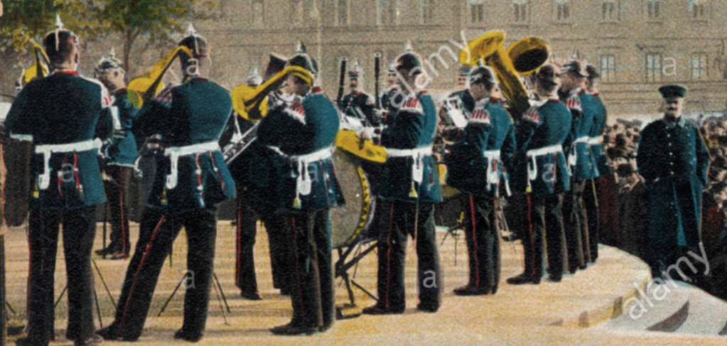
The Bassoon Reed in Early American Bands (1830-1950)
Stuart Young II

Slide 2
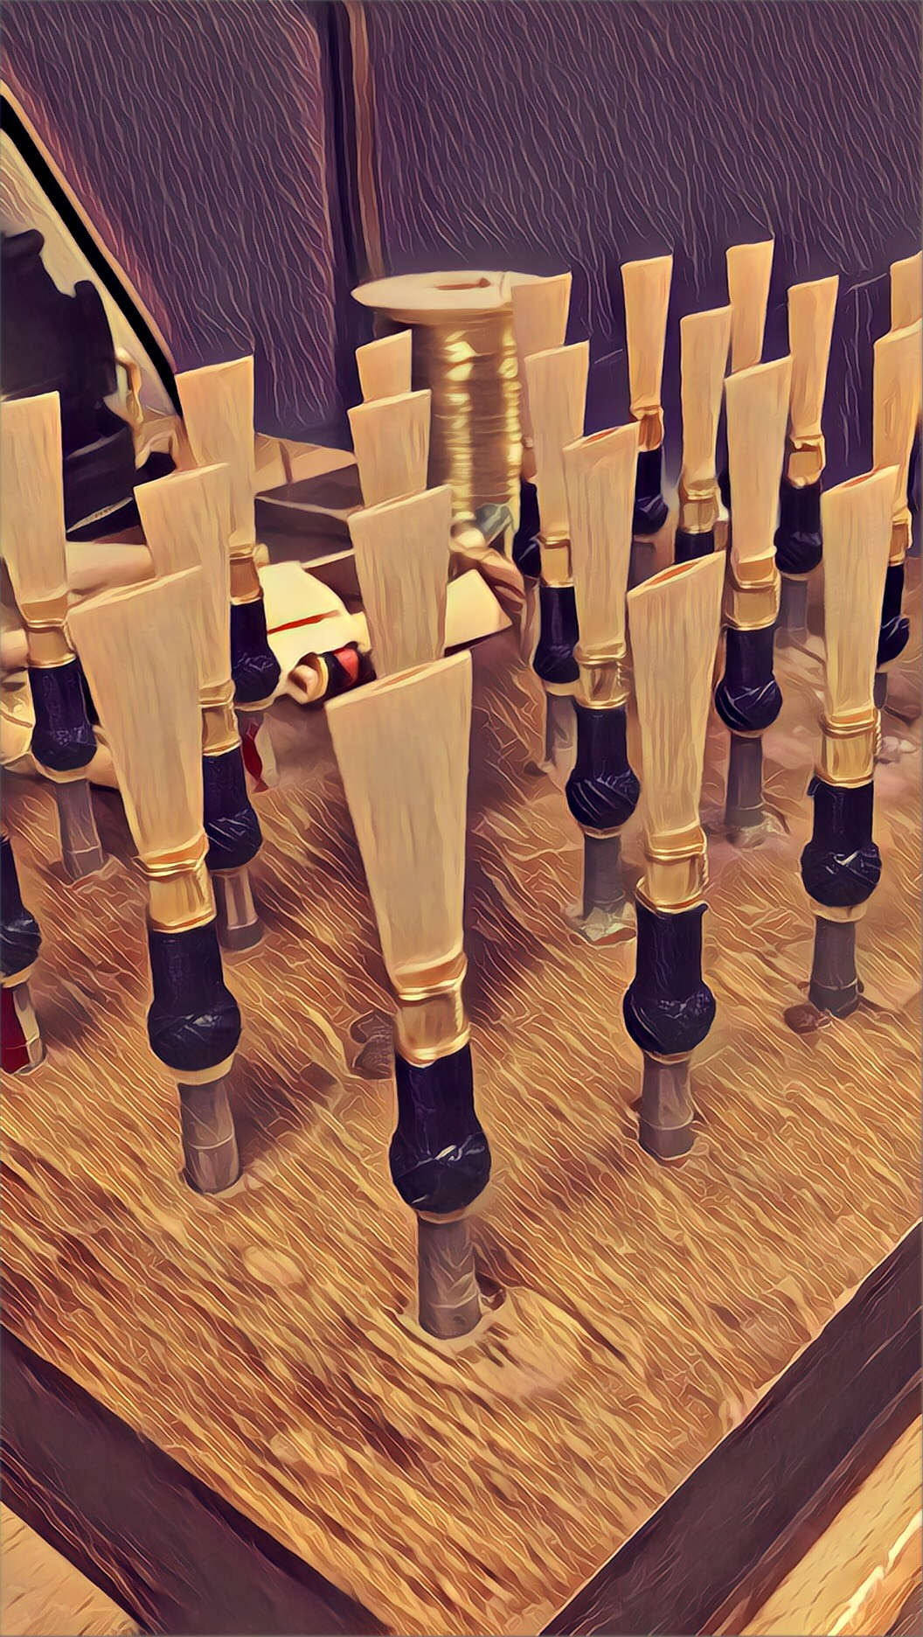
How I Conducted the Research
Analyzed early American band scores for clues, compared to European music around the time.
Assessed the level of difficulty of band scores, compared to scores in Europe.
Formulated reed designs that fit the band’s performance criteria.
Compared those designs to other European/orchestral designs.

Slide 3
19th Century American Band Excerpts:
Ex. 1 - Finale to Act 1 of Gustavus the III, by Arber. 1834. mm. 1-9
Ex. 2 - Overture to La Reine de Saba by Gounod. 1884. mm. 477-484

Slide 4
19th Century Orchestral Excerpt List:
Orchestral Example and Excerpt List:
Symphony No. 4 in Bb Major, Op. 60, Ludwig van Beethoven, 1806.
Symphonie Fantastique, Hector Berlioz, 1830.
“Una furtiva lagrima” from L'elisir d'amore, Gaetano Donizetti, 1831.
Grande Symphonie funèbre et triomphale, Hector Berlioz, 1840.
Tannhäuser und der Sängerkrieg auf Wartburg, Richard Wagner, 1845.
Symphony No. 4 in F minor, Peter Tchaikovsky, 1877.
Scheherazade, Rimsky-Korsakov, 1888.
The Sorcerer’s Apprentice, Paul Dukas, 1897.
Bassoon Solo Literature:
Weber’s Hungarian Fantasy and Rondo, Op. 35, 1813.
Weber’s Bassoon Concerto in F Major, Op. 75, 1822.
Crusell’s Bassoon Concertino in Bb Major, 1829.
Ferdinand Bassoon Concertino, Op. 12, 1838.
Rossini’s Bassoon Concerto, 1845.
Coenen’s Sonata for Bassoon in c minor, 1864.
Schreck’s Bassoon Sonata in F Major, 1887.

Slide 5
Early American Bassoon Reed Constraints (1830-1890):
Reeds needed to play within a comfortable range of Bb1 - F4.
(Western Literature had bassoons go as high as Bb4, and possibly higher)
Reeds needed to have “bite” in articulations.
(Early American band music utilized excessive articulations)
Reeds needed a dynamic range of solo piano (mp) to 2 f’s (ff).
(If it wasn’t loud, it wasn’t American proud!)
CONCLUSION: American Bassoon reeds needed to be short, wide at the tip, and did not need to be overly refined.

Slide 6
The American Reed Boom (1900-1920):
Bassoon Reeds Improve with Education
School band programs become popular, instrument manufacturers and composers contribute to the high school band culture.
CBDNA, WASBE, and the American Bandsman Association create festivals, competitions, and improve the music education.
In turn, the significant improvements to music education from 1900-1920 also gave bassoonists insight on refined, detailed reed adjustments.

Slide 7
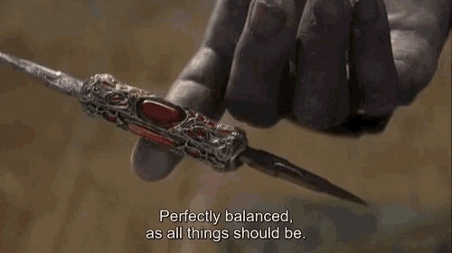
Nationalized Bassoon Reed Styles
German Style Reeds - Thick all around, with a wide tip and large blade. “Buzzy” tone with more overtones in the color. Great for rich sounds in the low-mid register.
French Style Reeds - Thin all around, especially at the tip. Narrow tip width and “nasally” tone, yet produces quality sounds in the mid-high register.
American Style Reeds - Mix of both German and French styles; shorter reed and wide tip, thin at the tip and thick in the back of the reed. Not as light as the French style, but not as “edgy” in sound as the German style.

Slide 8
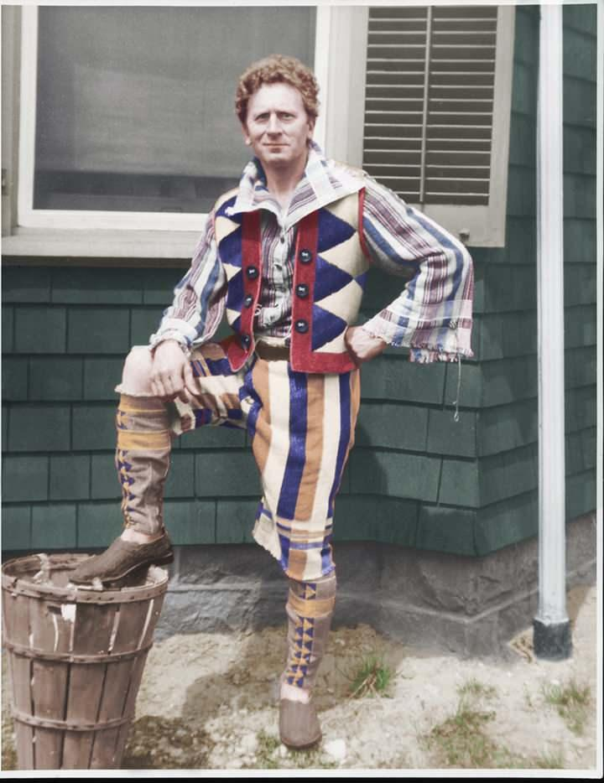
And then there’s this man...
Yes, this is Percy Grainger.
No, he is not single.

Slide 9
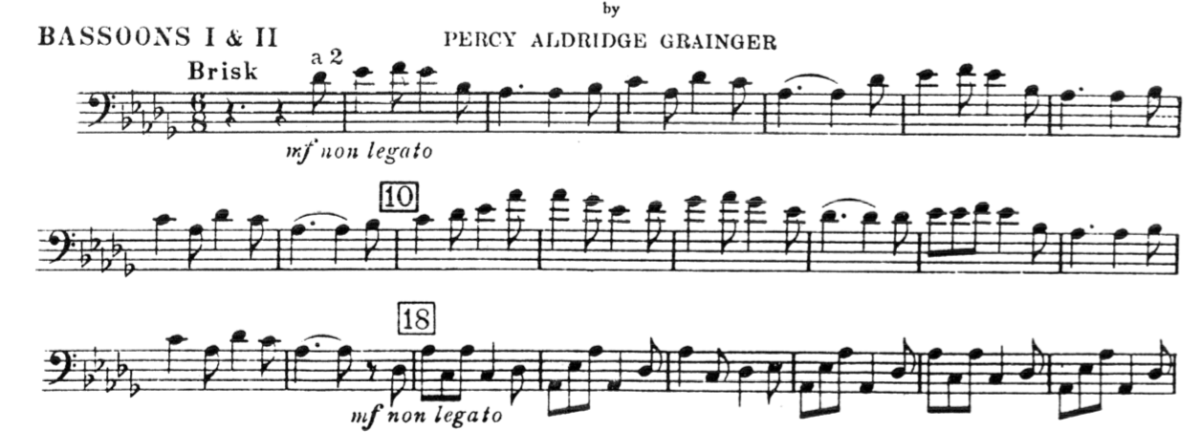
Early 20th Century American Band Music Examples:
Lincolnshire Posy, Dublin Bay, mm. 1-23. (bassoon 1 & 2). 1937.

Slide 10
Early 20th Century American Band Music Examples:
Lincolnshire Posy, Harkstow Grange, mm. 34 - end. 1937.

Slide 11
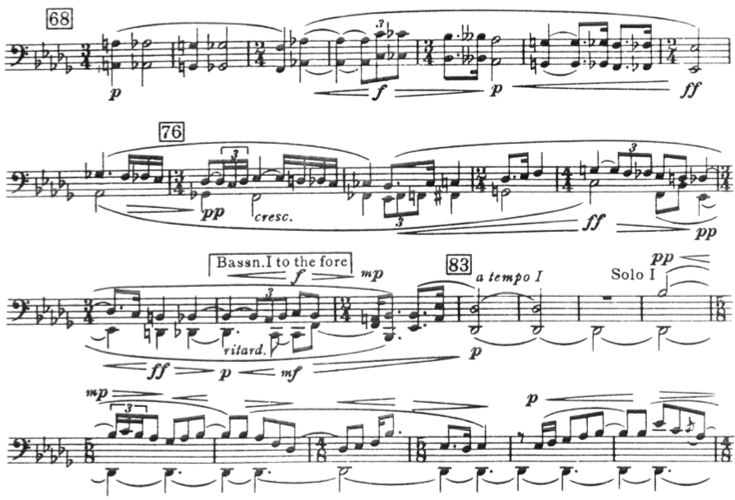
Lincolnshire Posy, Rufford Park Poachers, mm. 68-92. 1937.

Slide 12
Early American Bassoon Reed Constraints (1920-1945):
Reeds needed to play within a comfortable range of Bb1 - Bb4. (Caught up to Mozart Concerto)
Reeds needed to have MORE contrast in articulations.
Reeds needed a dynamic range of triple piano (ppp) to 3 f’s (fff).
CONCLUSION: Bassoon reeds were refined; thinner and narrow tip, thicker in the back, and generally lighter smaller in reed size.

Slide 13
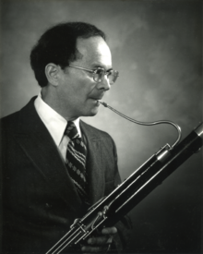
One Bassoon Reed Enthusiast:
Bernard Garfield (b. 1924)
Studied English Literature at New York University, received his masters in composition from Columbia University.
Principal Bassoonist for the Philadelphia Orchestra from 1957-2000.
Taught at Temple and Curtis Universities.
Submitted his findings on reed research for publication.

Slide 14
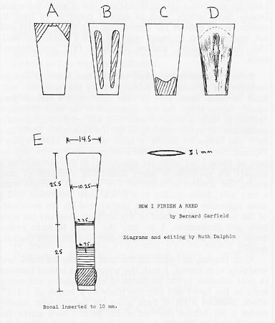
Garfield’s Hand Drawn Diagram
Shows the different areas to scrape on a reed.
Garfield inspired many bassoon teachers and reed enthusiasts to understand reeds on micro levels.

Slide 15
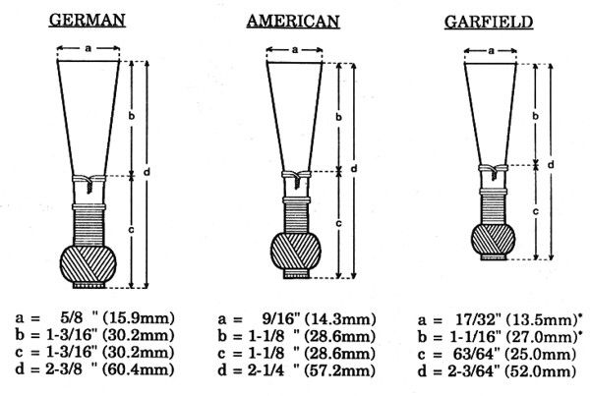
Diagram of Bassoon Reed Styles

Slide 16
Conclusion:
Not much was improved on American bassoon reed making methods from 1830-1900, because the music didn’t demand a whole lot from bassoonists.
American band ed. programs in the early 1900’s elevated the performance standards of all musicians, gave nationalistic identity to American style reed making, and refined reed making technique leading into early reed research.
As musicianship improved, music scores demanded more from bassoonists as well as their reeds.

Slide 17
Thank You!
Citations:
Corporan, Eugene Migliaro. Teaching Music through Performance in Band.Vol. 6., (Chicago, 2007).
Garfield, Bernard. “How I Finish a Reed.” The World’s Bassoonists.Vol. 1., No.3. (1970).
Grainger, Percy Aldridge. Lincolnshire Posy, No. 34. Augener Ltd., (London, 1940).
Hunsberger, Donald. Defining the Wind Band Sound. (New York. Publication).
Maslanka, David. Child’s Garden of Dreams. (New York: C. Fisher, 1988).
Rubinstein, Anton. Overture Triomphale, Op.43. (1855).

